Slide 1
OpenTimer: A high-performance timing analysis tool
https://github.com/OpenTimer/OpenTimer
Tsung-Wei Huang and Martin D. F. Wong
Department of Electrical and Computer Engineering (ECE)
University of Illinois at Urbana-Champaign (UIUC), IL, USA
Notes:
ECE Main Slide

Slide 2
Outline
Problem formulation recap
Incremental timing and incremental CPPR
OpenTimer architecture
Tool overview and features
Core algorithm (IO, graph reduction, pipeline scheduling)
Experimental results
TAU 2015 contest benchmarks
Conclusion

Slide 3

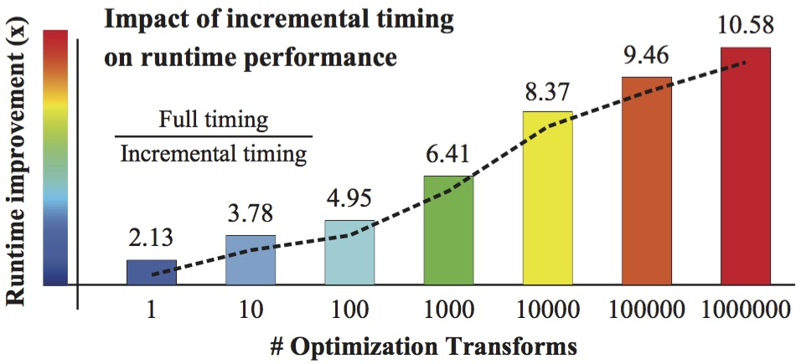
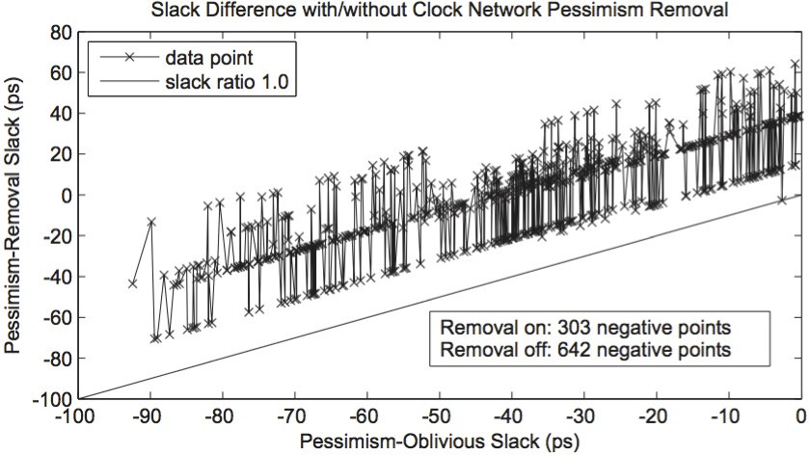
Problem Formulation – TAU 2015 Contest
A tool deals with incremental timing and incremental CPPR
Important for timing-driven applications
Fast full timing and incremental timing analysis
Capability of path-based CPPR analysis
Parallel programming and multi-threading
CPPR impact
(reduction of unwanted pessimism)
*CPPR stands for Common Path Pessimism Removal

Slide 4
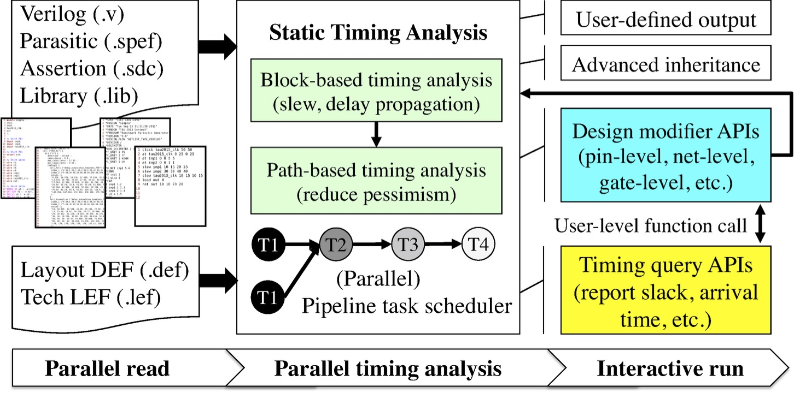
OpenTimer Architecture
An open-source high-performance timing analysis tool
TAU14 (1st place), TAU15 (2nd place)
ICCAD15 (golden timer), TAU16 (golden timer)
Feature highlights
C++11
Industry format
STA engine
Block-based
Path-based
Incremental
Lazy evaluation
CPPR
Multi-threaded
https://github.com/OpenTimer/OpenTimer

Slide 5
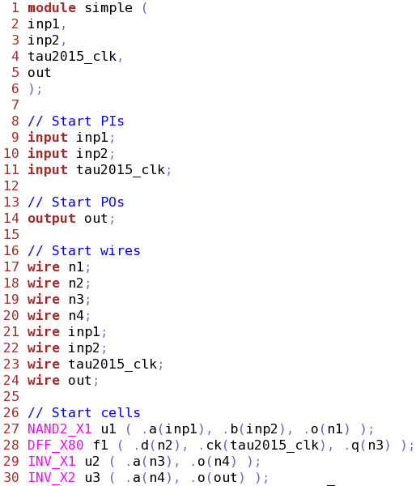
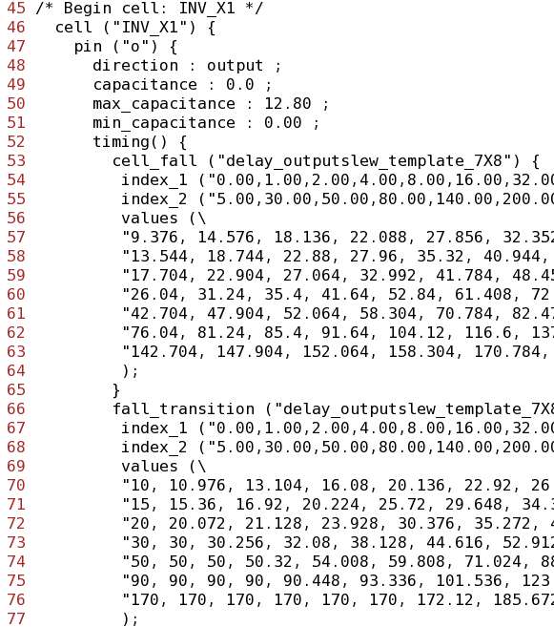
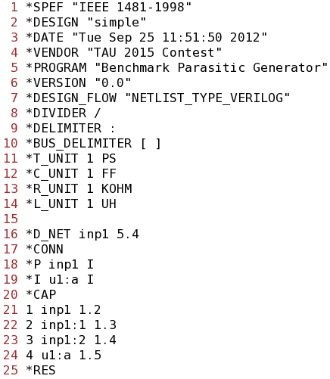
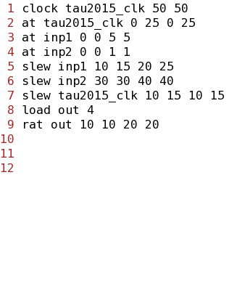
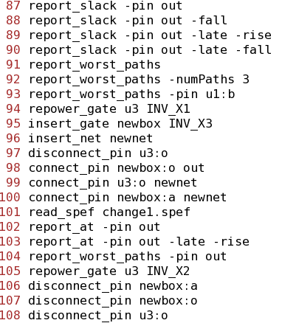
Initialize the Timer – Parallel IO
A set of design files that follow the industry standard format
Verilog netlist, two libraries (early and late), parasitic spef, etc.
Time-consuming IO (e.g., file IO, complex parsing)
Task graph
Input files (industry standard)
Library (Early)
Library (Late)
Build internal data structure
Design Connectivity
Early and Late Libraries
Design Parasitics
Verilog
Verilog (.v)
Liberty (.lib)
SPEF (.spef)
Assertions
Operations
Parasitic
LEF
DEF
Assertion
Parallel dependency generation using portable OpenMP
#pragma parallel …
#pragma task ...
(.timing)
(.ops)
Based on TAU 2013, ISPD 2013, ICCAD 2014, Cadence Benchmarks
x2 speedup by parallel read/parse!

Slide 6
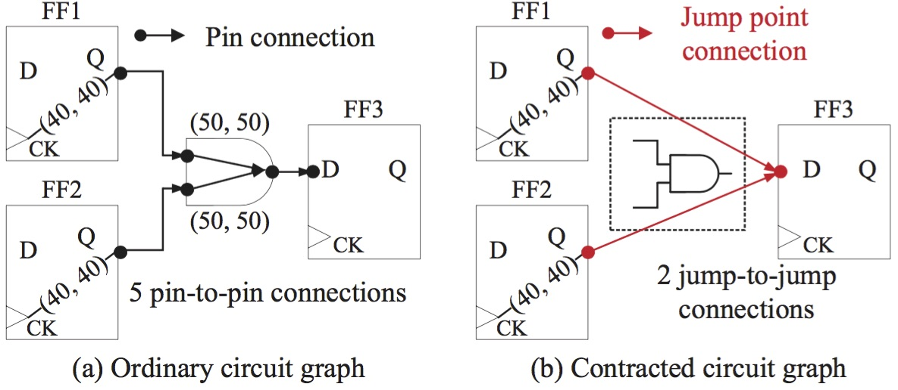
Timing Graph Reduction
Reduce the search space
Identify tree-structured subgraphs in the original timing graph
Merge every leaf-root path (transition-definite)
~30% reduction on the graph size
Apply to combinational circuits only
R
F
F
R
R
Every leaf-root path can be uniquely defined
(given a transition at an endpoint)

Slide 7
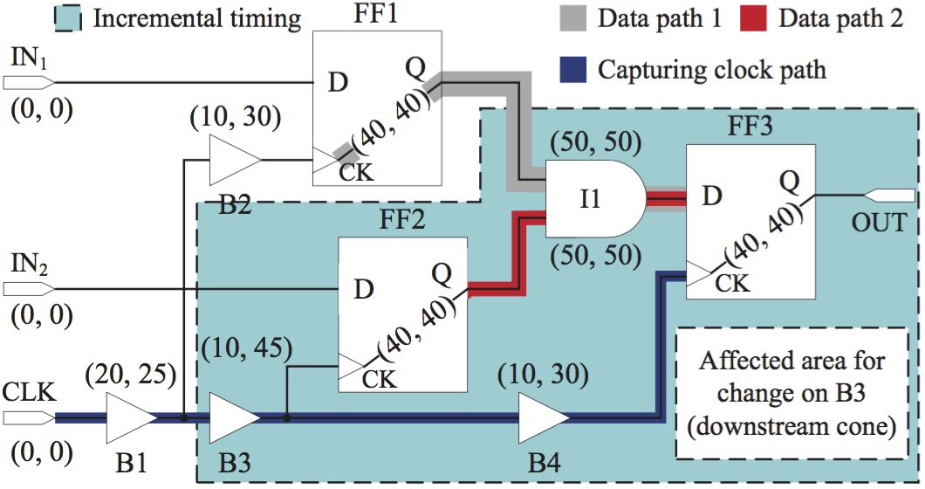
Key Components of Incremental Timing
Full timing is just a special case of incremental timing
Design modifiers
Pin-level operations, net-level operations, and gate-level operations
Timing queries
Slack
Arrival time
Required time
TNS and WNS
Critical path report
CPPR
Source of propagation
Lazy evaluation
Explore parallel incremental timing

Slide 8
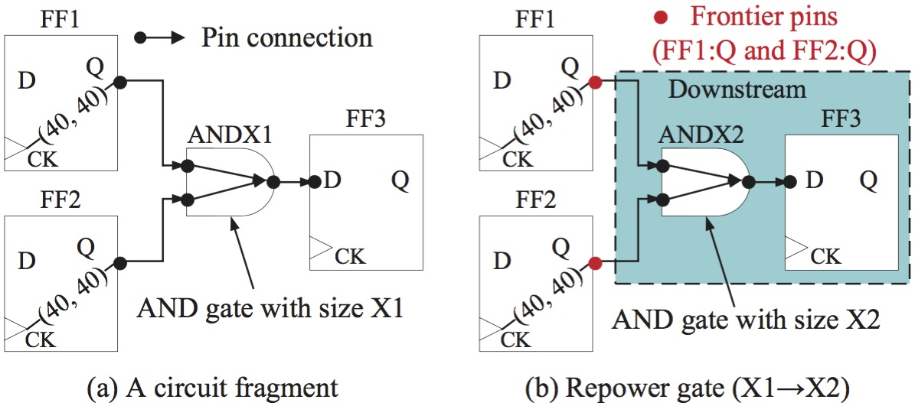
Identify the Source of Incremental Timing (I)
Source of incremental timing
Pins where the next timing propagation must originate from
Referred to as “frontier pins”
Repower gate (gate sizing)
repower_gate<gate_name, new_cell_name>
Go one-level up from the gate
Frontier pins
(FF1:Q and FF2:Q)

Slide 9
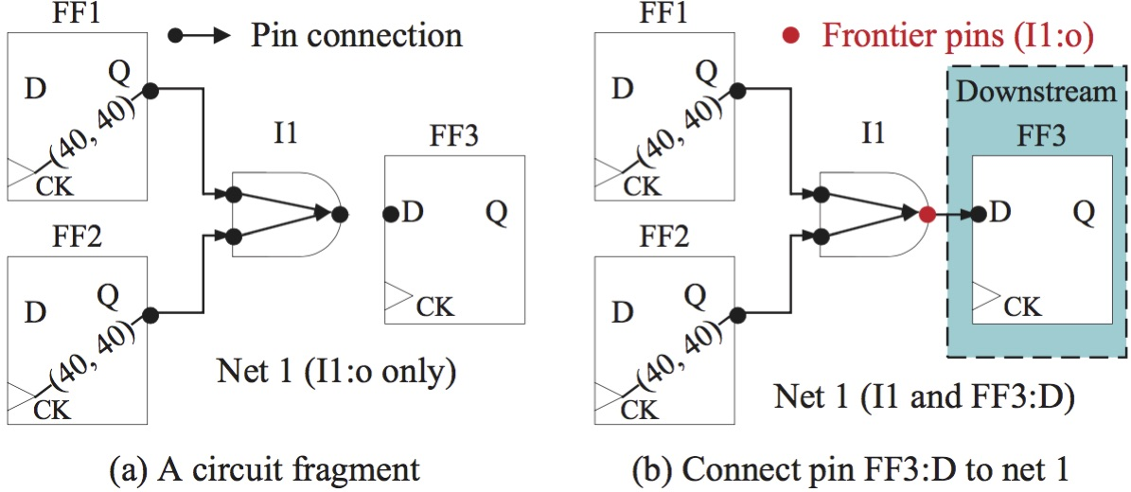
Identify the Source of Incremental Timing (II)
Disconnect pin (disconnect a pin from its net)
disconnect_pin <pin_name>
Affect RC network only
Incremental timing from the root
Find the root of the corresponding RC network (RC tree)
Load cap changed
Frontier pins
(I1:O and FF3:D)

Slide 10
Identify the Source of Incremental Timing (III)
Connect pin (connect a pin to a net)
connect_pin <pin_name, net_name>
Affect RC network only
Incremental timing from the root
Find the root of the corresponding RC network (RC tree)
Load cap changed
Frontier pins
(I1:O and FF3:D)

Slide 11
Dealing with Design Modifiers
Design modifiers can be built upon pin-level modification
remove_net: disconnect all pins and remove the net
insert_net: create an empty net
insert_gate: insert a gate and create pins
remove_gate: disconnect all input and output pins, and remove the gate
…
How to store frontier pins for correct timing propagation?
Timing graph is a directed acyclic graph (DAG)
Efficient data structure, bucketlist, to maintain the dependency
Apply topological sort (longest path finding)
Level index of each pin to keep track of dependency
Every frontier pin is inserted into the corresponding bucket
Incremental topological sort for incremental levelization

Slide 12
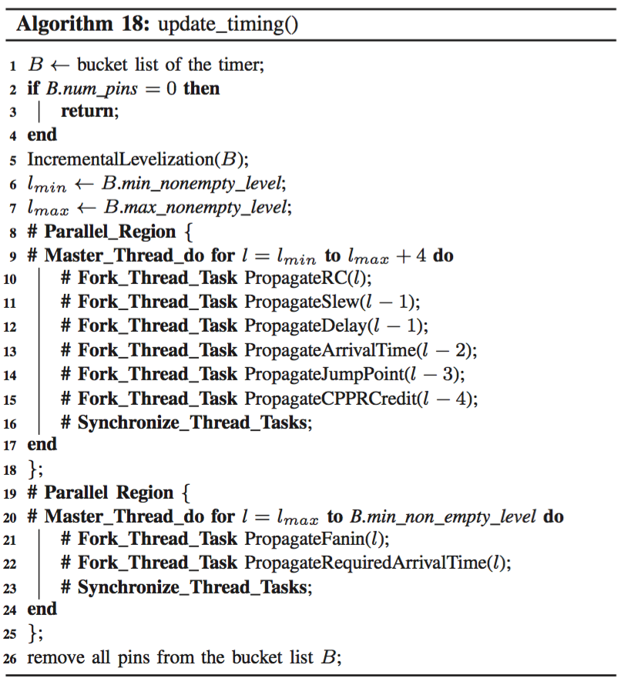
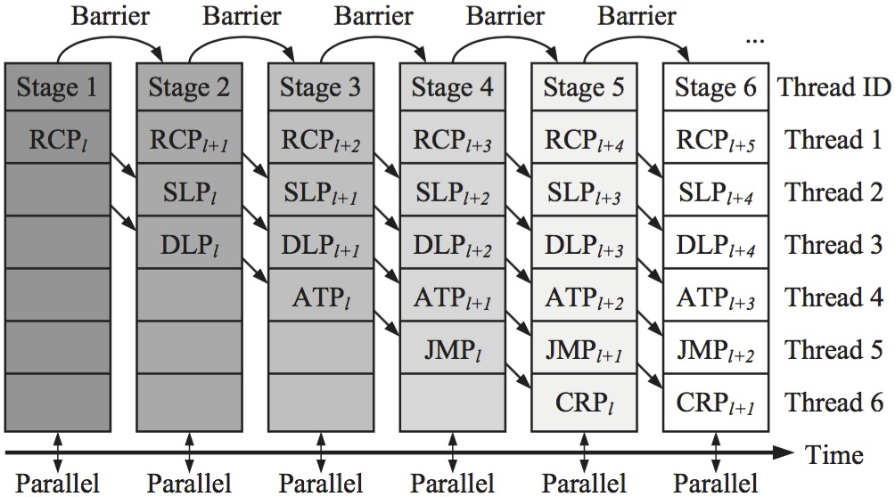
Pipeline-based Parallel Timing Propagation
Timing propagation has several linearly dependent tasks
RC update → Slew & Delay → Arrival time → Jump point → CPPR
Pipeline scheduling with multiple threads
We use the following paper for dealing with CPPR
*UI-Timer: An ultra-fast clock network pessimism removal algorithm, T.-W. Huang, P.-C. Wu, and Martin D. F. Wong, ICCAD14

Slide 13
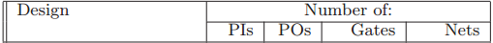
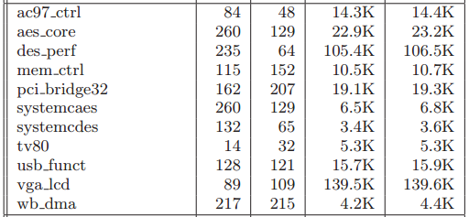
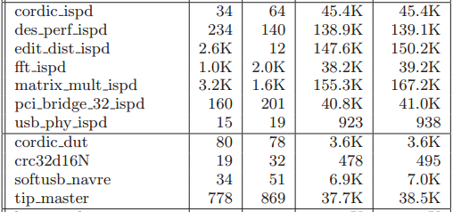
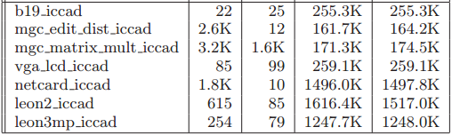
Experimental Results – Environment Setup
Implementation
C++11 with GCC 4.8
Linux machine (8 cores)*
Benchmark suite
TAU15 contest benchmarks
Baseline on TAU15 winners
iTimerC 2.0 (1st place)
iitRACE (3rd place)
*
*
*
*
*clock tree has inverters and buffers
7 based on released benchmarks (~10² – ~10⁵ gates)
3 based on Cadence benchmarks (~10² – ~10⁵ gates)
6 based on ICCAD 2014 benchmarks (~10⁵ – ~10⁶ gates)
*Campus cluster, University of Illinois at Urbana-Champaign (UIUC)
https://campuscluster.illinois.edu/

Slide 14
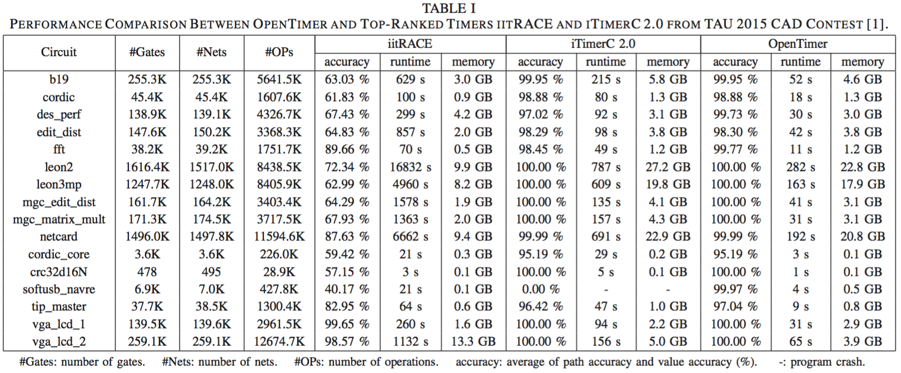
Experimental Results – Overall Performance Comparison
*iTimerC 2.0: 1st place in TAU contest 2015 (binary from authors)
*iitRACE: 3rd place in TAU contest 2015 (binary from authors)

Slide 15
Experimental Results – Performance Highlights
OpenTimer performance highlights
Achieved the highest accuracy (both path-based and value-based)
Achieved the fastest runtime (x2 to x9 speedup)
Robust and reliable (no crash)
Small memory usage*
Comparison to the newest results of iTimerC 2.0**
netcard (1.5M gates and 1.5M nets)
OpenTimer: 192s, 20GB
iTimerC 2.0: 213s, 21GB
leon3mp (1.2M gates and 1.2M nets)
OpenTimer: 163s, 18GB
iTimerC 2.0: 186s, 19GB
iTimerC 2.0 runs in 3.5GHz CPU!
OpenTimer runs in 2.2GHz CPU!
* Our contest version has higher memory usage is due to the different system environment settings between IBM machine and UIUC machine
**iTimerC 2.0: Fast incremental timing and CPPR analysis, ICCAD15

Slide 16
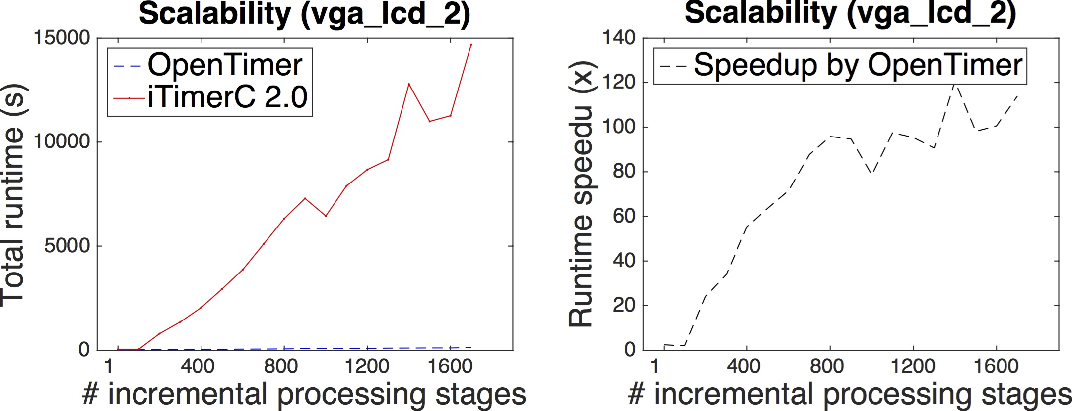
Experimental Results – Scalability of Incremental Timing
Optimization or synthesis tools
Call an incremental timer millions of times to optimize the timing objective
One incremental processing stage
A set of design modifiers followed by a timing query
Insufficiency of TAU15 benchmarks
Only 5~10 incremental processing stages…
x115 speedup by OpenTimer
(at 1459th stage)
X2.7 speedup by OpenTimer
(at 1th stage, i.e. full timing)
Notes:
Our tool is truly incremental

Slide 17
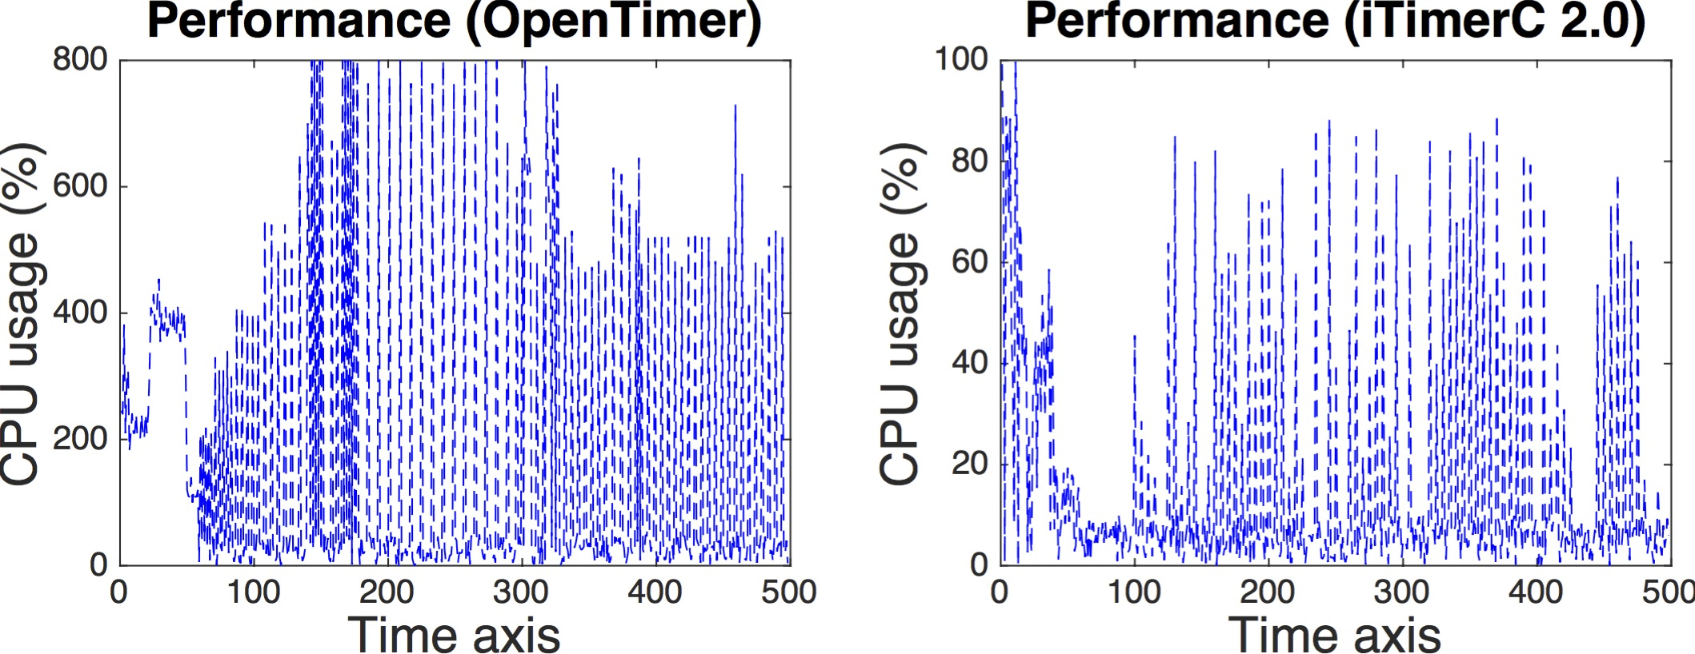
Experimental Results – Parallelism Comparison
Capability of multi-threading
Higher parallelism translates to higher cpu usage
Better resource utilization reflects on higher cpu usage
Parallel IO by OpenTimer
Parallel timing by OpenTimer
Single thread by iTimerC 2.0
(no parallelism)

Slide 18
Conclusion
Developed a high-performance timing analysis tool
Free software and open-source under GPL v3.0
Industry format (.v, .spef, .lib, .lef, .def, etc.)
Fast, accurate, and robust
Multi-threaded and CPPR by default
Recognition
1st prize in TAU14 contest (full timing with CPPR)
2nd prize in TAU15 contest (incremental timing with CPPR)
Golden timer in ICCAD15 CAD contest
Golden timer in TAU16 contest
Acknowledgment
Jin, Billy, M.-C., team iTimerC, team iitRACE, and the UIUC CAD group!

Slide 19
OpenTimer Community

